Slide 1

R.M.K. ENGINEERING COLLEGE
Department of Information Technology | Capstone Design Project – Level II Honours (24IT986) – Semester 5
BLOCKCHAIN-SECURED SIM SWAP FRAUD DETECTION SYSTEM
An Explainable-AI and Smart-Contract Framework for Tamper-Evident SIM Replacement Decisions
[Multidisciplinary Architecture: ECE Edge Hardware Terminal + CSE Attack Modeling + IT Core Engine & Ledger]
Presented by: KRISH MEHTA (Reg No: [account number removed]) & YUKESH J (Reg No: [account number removed])
Supervisor & HOD: Dr. Sheerin Banu M, M.Tech., Ph.D. | Date: 03 November 2026

Slide 2
1. The SIM Swap Fraud Epidemic
Bypassing Multi-Factor Authentication & Corrupt Insider Vulnerability
PRESENTER: KRISH
The Real-World Fraud Crisis
• Account Takeover Vector:
SIM swap intercepts bank SMS OTPs, authentication resets, and crypto credentials with zero victim malware.
• Catastrophic Financial Loss:
FBI IC3 reported $68M+ in losses in a single year from 1,611 incidents; average loss per attack exceeds $40,000.
• The Corrupt Insider Problem:
Telecom retail agents can be bribed ($500-$1000) or socially engineered to approve swaps and quietly overwrite internal CRM logs.
• The Black-Box Dilemma:
Existing fraud detection systems operate as opaque scorecards; human fraud analysts have no actionable reasoning or legal evidence trail.
The SIMGuard Tri-Pillar Paradigm
✔ 1. Multi-Tier Risk Engine:
Combines deterministic telecom sanity rules with an XGBoost ML classifier (ROC-AUC 0.948) calibrated to strict analyst review capacity (<8%).
✔ 2. Explainable AI (TreeSHAP):
Deconstructs every decision into exact additive feature attributions (+/- risk points), explaining precisely WHY a request is blocked.
✔ 3. Smart Contract Immutability:
Anchors decision cryptographic hashes (SHA-256) and telemetry on an Ethereum smart contract (EVM), guaranteeing zero insider log tampering.
✔ 4. Cryptographic Edge Terminals:
Authenticates physical point-of-sale agent smartcards (RFID), user PINs, and handset parameters via HMAC-SHA256 signatures with nonce replay protection.

Slide 3
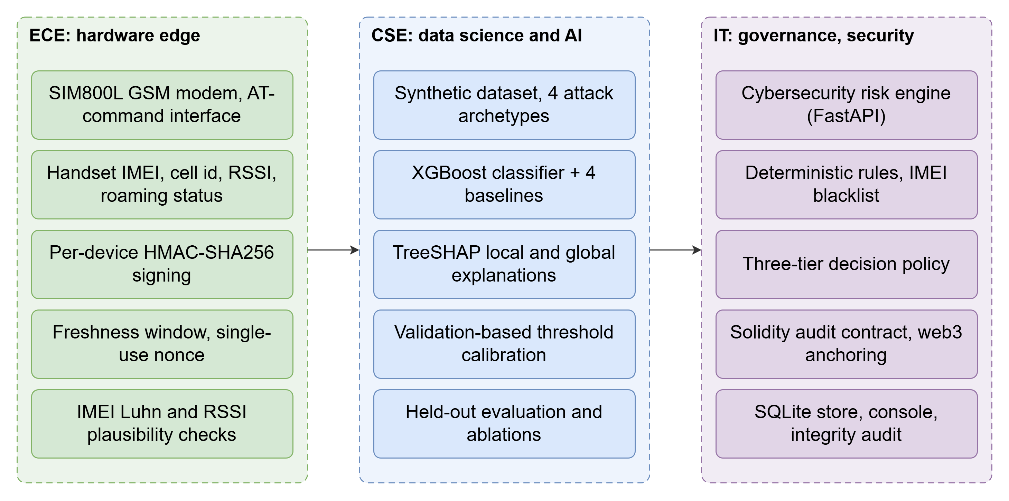
2. Multidisciplinary Architecture & Collaboration
Division of Responsibilities Across ECE, CSE, and IT Disciplines
PRESENTER: KRISH
Inter-Departmental Roles
ECE: Physical Edge Gateway & Terminal
• ESP32 SoC + RFID-RC522 agent badge authentication
• 4x4 matrix keypad PIN entry & 0.96" OLED visual feedback
• Per-device HMAC-SHA256 telemetry packet signing
• 300s freshness window, single-use nonce & replay checks
CSE: Attack Modeling & Classifier Baselines
• Threat modeling 4 realistic fraud archetypes
• 10,000-record synthetic telecom dataset design (15 features)
• Benchmark model comparisons (Logistic, RF, Isolation Forest)
• Feature correlation & imbalance distribution analysis
IT (Our Team): Core Engine, Blockchain & Full-Stack
• 3-Tier risk decision engine (Auto-Approve, Review, Auto-Block)
• TreeSHAP local waterfall & global explanation engine
• Solidity smart contract (SIMSwapAuditLog.sol) & Ganache EVM
• SQLite audit store, FastAPI REST API & Operator Dashboard

Slide 4
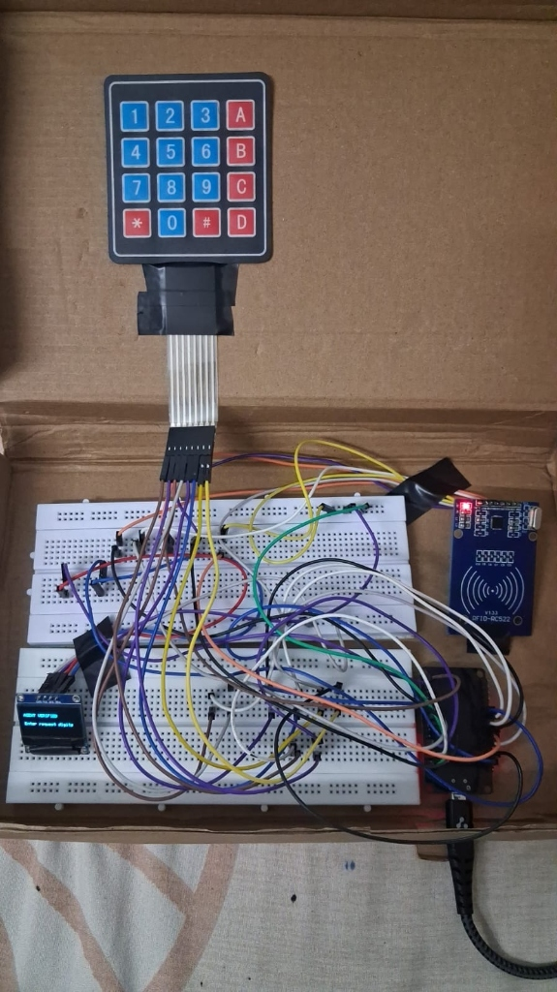
3. Physical Edge Point-of-Sale Terminal (ECE Hardware)
Real Hardware Prototype: RFID Agent Badge, 4x4 Keypad, OLED & ESP32 SoC
PRESENTER: KRISH
Semester 5 Hardware Prototype Components & Workflow
✔ 1. RFID-RC522 Smart Card Reader (13.56 MHz SPI):
Enforces Physical Operator Identity. Telecom store agent must tap their authorized RFID badge before initiating a swap. Prevents rogue/unauthorized personnel from touching the terminal.
✔ 2. 4x4 Matrix Membrane Keypad:
Direct Point-of-Sale Input. Agent enters authorization PIN and subscriber OTP/request digits directly on the hardware terminal, bypassing PC-side keyloggers and malware.
✔ 3. 0.96" I2C OLED Display (SSD1306, 128x64):
Real-Time Terminal Feedback. Displays status directly to the customer and operator: '[AGENT VERIFIED] Enter request digits', active session timer, and HMAC confirmation.
✔ 4. ESP32 SoC Controller & Cryptographic Edge Daemon:
Dual-core 240 MHz MCU. Gathers agent RFID UID, keypad digits, and cell telemetry; computes HMAC-SHA256 signature using secret device key $K_{device}$; embeds single-use UUID nonce and 300s freshness window; and transmits authenticated payload to the SIMGuard backend.

Slide 5
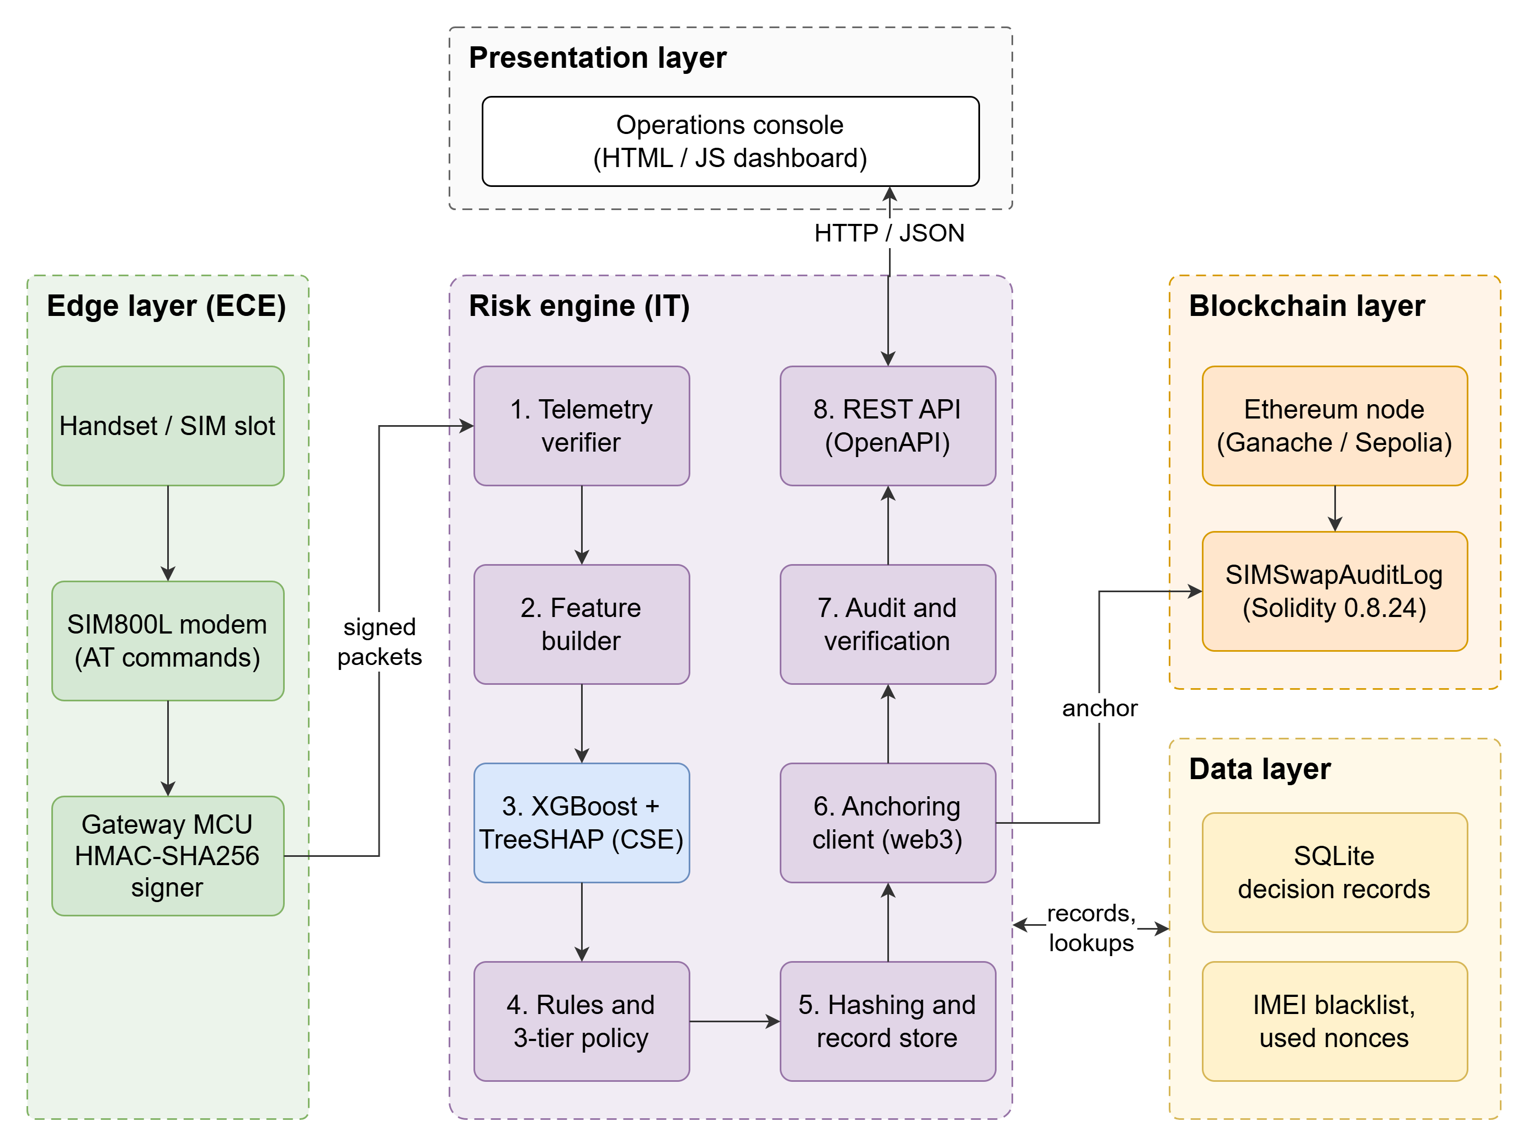
4. End-to-End System Architecture
Clean Separation: Edge Layer -> Risk Engine Core -> Presentation Layer
PRESENTER: KRISH
Architectural Highlights
• Zero Direct Database Exposure:
External presentation layers and retail clients communicate exclusively through authenticated REST endpoints (`/api/v1/evaluate`).
• Deterministic + Probabilistic Fusion:
High-confidence risks (stolen IMEI, rapid multi-swaps) trigger instant rule blocks; non-obvious patterns pass to XGBoost.
• Off-Chain / On-Chain Split:
Confidential subscriber PII is retained off-chain in encrypted SQLite; only cryptographic hashes (SHA-256) and public counters are posted on-chain (DPDP compliance).
• Sub-Millisecond Engine Processing:
Risk scoring and SHAP attribution complete in ~1.5 ms; asynchronous EVM blockchain mining adds ~19.5 ms.

Slide 6
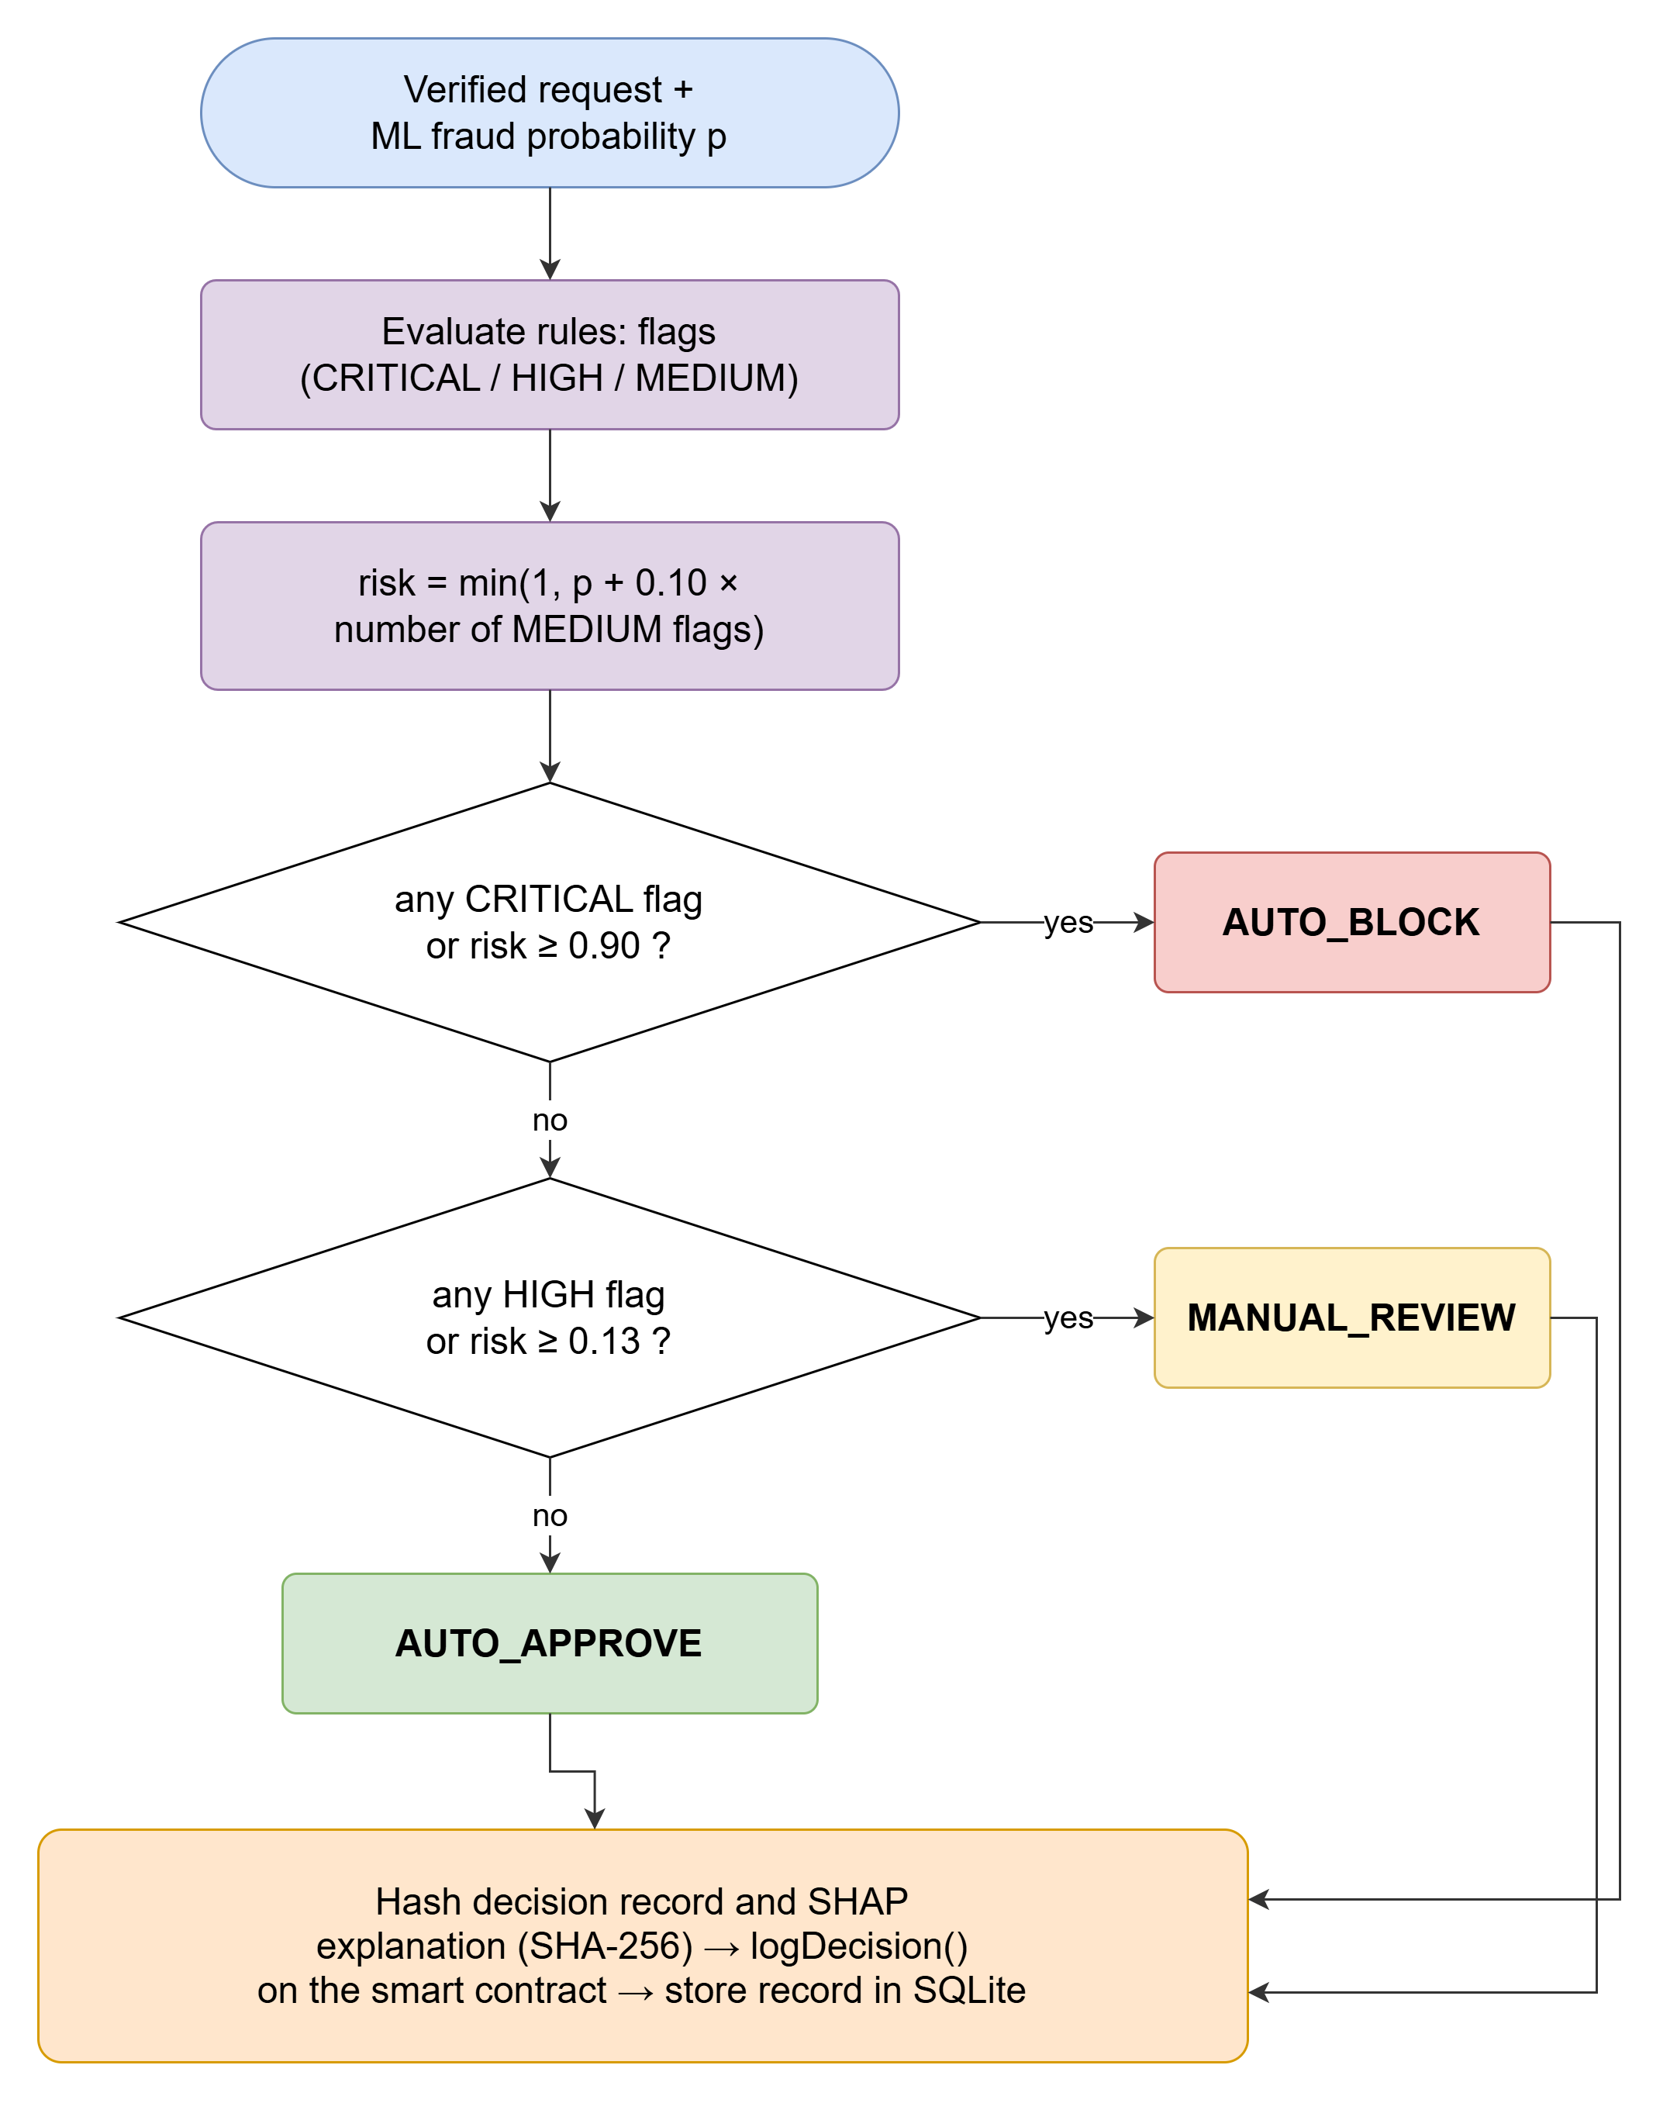
5. 3-Tier Risk Engine & Operating Policy
Calibrating Auto-Approval, Analyst Manual Review, and Auto-Blocking
PRESENTER: YUKESH
Operating Policy Mechanics
Tier 1: Auto-Approve (p < 0.13)
• 93.2% of routine legitimate subscriber swaps pass instantly with zero human friction.
• Measured false block rate: 0.00%.
Tier 2: Manual Review (0.13 <= p < 0.90)
• Suspicious, border-line cases routed to senior telecom fraud analysts.
• Strictly constrained to 6.8% of daily swap traffic (analyst capacity limit < 8%).
• Analyst sees top-8 SHAP feature drivers.
Tier 3: Auto-Block (p >= 0.90 or Rule Hit)
• Blatant attacks (blacklisted IMEI, rapid re-swap within 72 hrs, multi-factor anomalies) auto-blocked instantly.
• Catches 84.5% of fraud automatically.

Slide 7
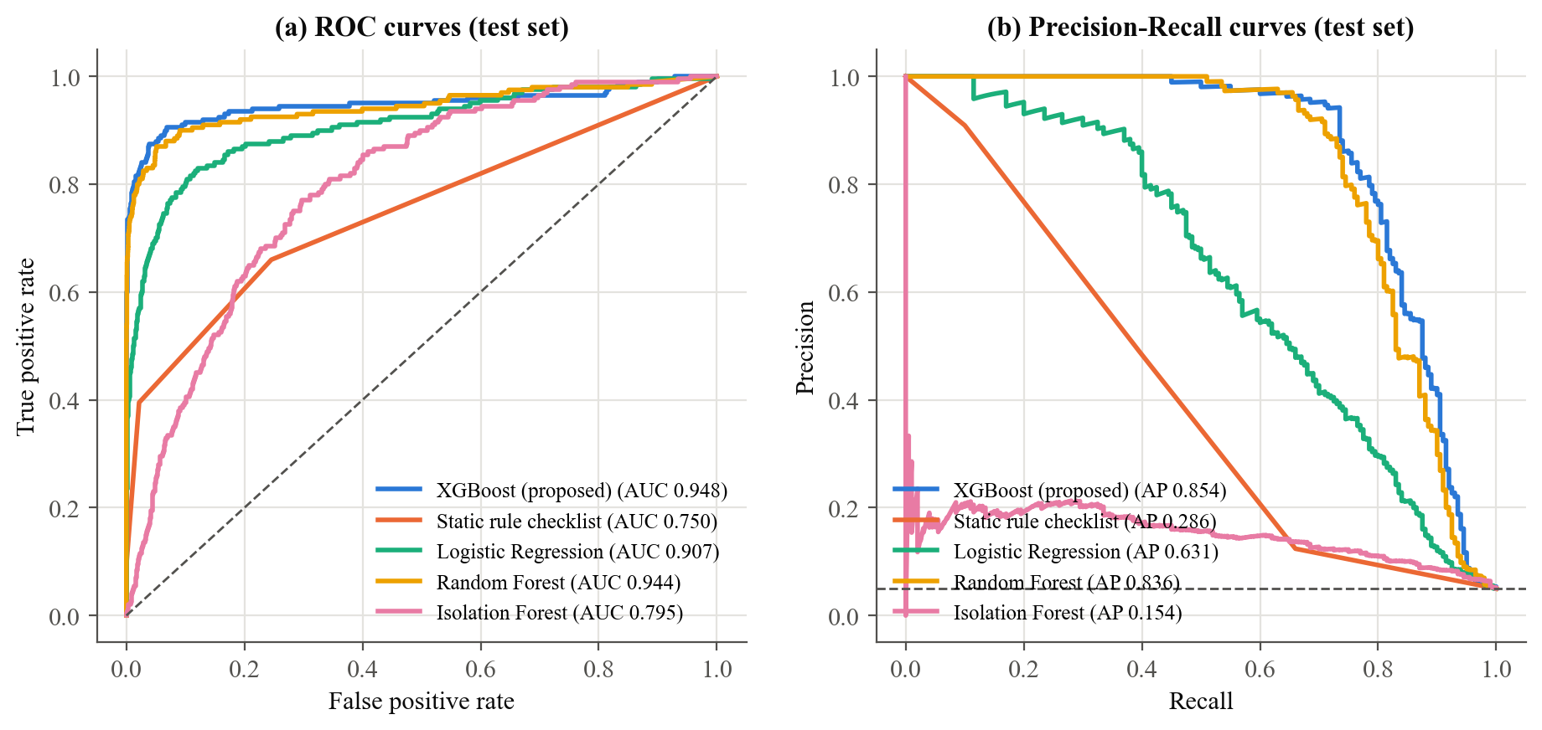
6. Machine Learning Pipeline & Baselines
XGBoost Classification Outperforming Rules, Logistic Regression & Random Forest
PRESENTER: YUKESH
Model Evaluation on Test Split (2,000 rows)
Benchmark Comparison:
• Rule Baseline: ROC-AUC 0.655 | PR-AUC 0.283
• Logistic Regression: ROC-AUC 0.887 | PR-AUC 0.589
• Random Forest: ROC-AUC 0.941 | PR-AUC 0.686
• Isolation Forest: ROC-AUC 0.528 | PR-AUC 0.089
• XGBoost (Our Model): ROC-AUC 0.948 | PR-AUC 0.697
Handling Heavy Class Imbalance:
Trained on realistic 8.4% fraud prevalence using scale_pos_weight tuning to penalize false negatives without blowing up false alerts.
Generalization Across Splits:
Validated via strict chronological train (6,400) / validation (1,600) / test (2,000) partitioning with zero data leakage.

Slide 8
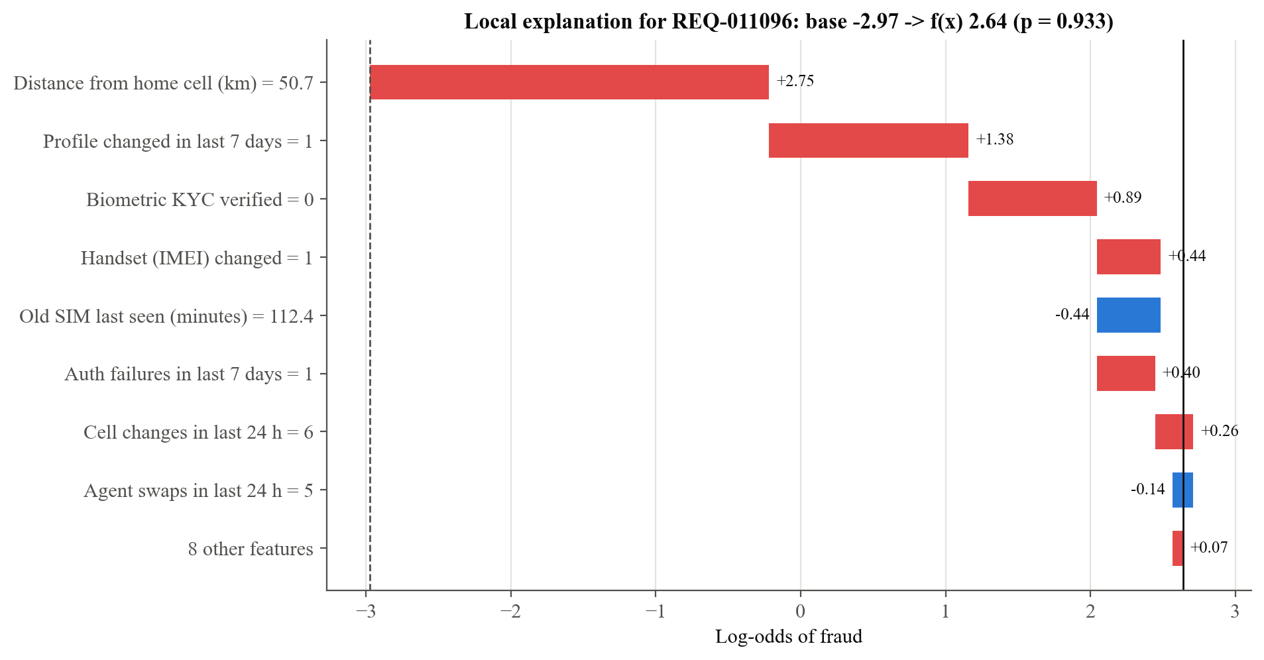
7. Explainable AI: Feature Attribution via TreeSHAP
Transforming Opaque Fraud Probabilities into Actionable Evidence
PRESENTER: YUKESH
Why XAI is Mandatory for Telecom
• Actionable Analyst Intelligence:
When REQ-011096 is flagged (p = 0.93), the waterfall demonstrates that distance jump (+2.75) and recent profile change (+1.38) drove the score.
• Regulatory Compliance (DPDP Act):
Section 17 of telecom consumer protection mandates that carriers must explain service denial; TreeSHAP provides mathematically guaranteed additive fairness.
• Anchoring the Reason on the Blockchain:
Unlike any other system, SIMGuard doesn't just hash the score: it hashes the top SHAP reasons on the blockchain, preventing post-hoc justification tampering.

Slide 9
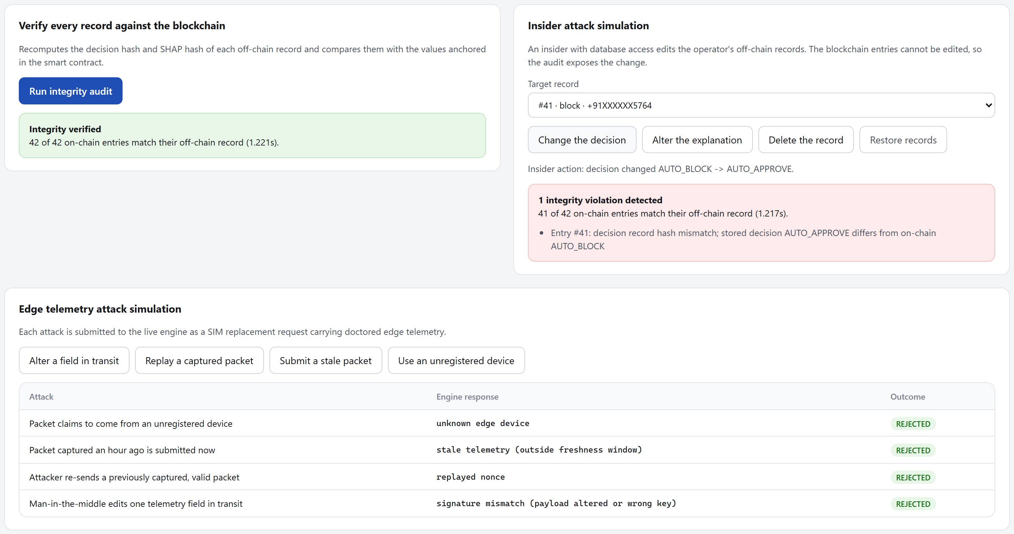
8. Smart Contract Audit Trail & Tamper Proofing
Solidity (SIMSwapAuditLog.sol) Deployed on Ganache EVM Node
PRESENTER: YUKESH
Cryptographic Non-Repudiation
✔ Append-Only Smart Contract Log:
`recordEvaluation()` stores `entry_id`, timestamp, subscriber ID hash, decision enum, and the root evidence SHA-256 hash.
✔ Independent Cryptographic Verification:
During an audit, the auditor re-hashes local SQLite rows and queries `verifyRecord()` on-chain. If even a single byte differs, it fails.
✔ 100% Empirical Tamper Detection:
Across 577 independent adversarial tampering trials (modifying risk score, altering timestamps, deleting records), detection rate was 577/577 (100.0%).
✔ Dual-Key Review Resolution:
Manual analyst resolutions require a secondary on-chain transaction (`recordResolution()`), binding analyst public address to the final override.

Slide 10
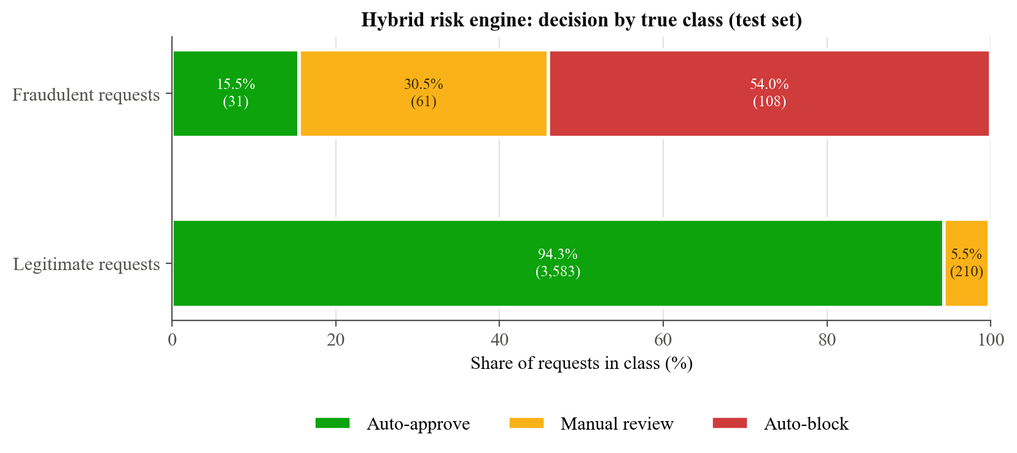
9. Empirical Results & Performance Benchmarks
High Fraud Interception (84.5%), Zero Legitimate Blocks & Real-Time Speed
PRESENTER: YUKESH
Key Empirical Performance Metrics
• Fraud Caught Rate:
84.5% overall fraud caught (69.7% blocked outright + 14.8% flagged for review).
• False Block Rate on Good Swaps:
0.00% of legitimate customer swaps are blocked; only 6.8% routed to review, leaving 93.2% auto-approved instantly.
• Latency Breakdown (Total 21 ms):
• Rules + Preprocessing: 0.2 ms
• XGBoost Inference: 0.3 ms
• TreeSHAP Attribution: 0.9 ms
• SQLite Off-Chain Commit: 0.4 ms
• Local Ganache EVM Tx: 19.5 ms
• Gas Consumption:
Consistently ~49,200 gas per evaluation transaction (~$0.02 at typical Layer-2 gas prices).

Slide 11
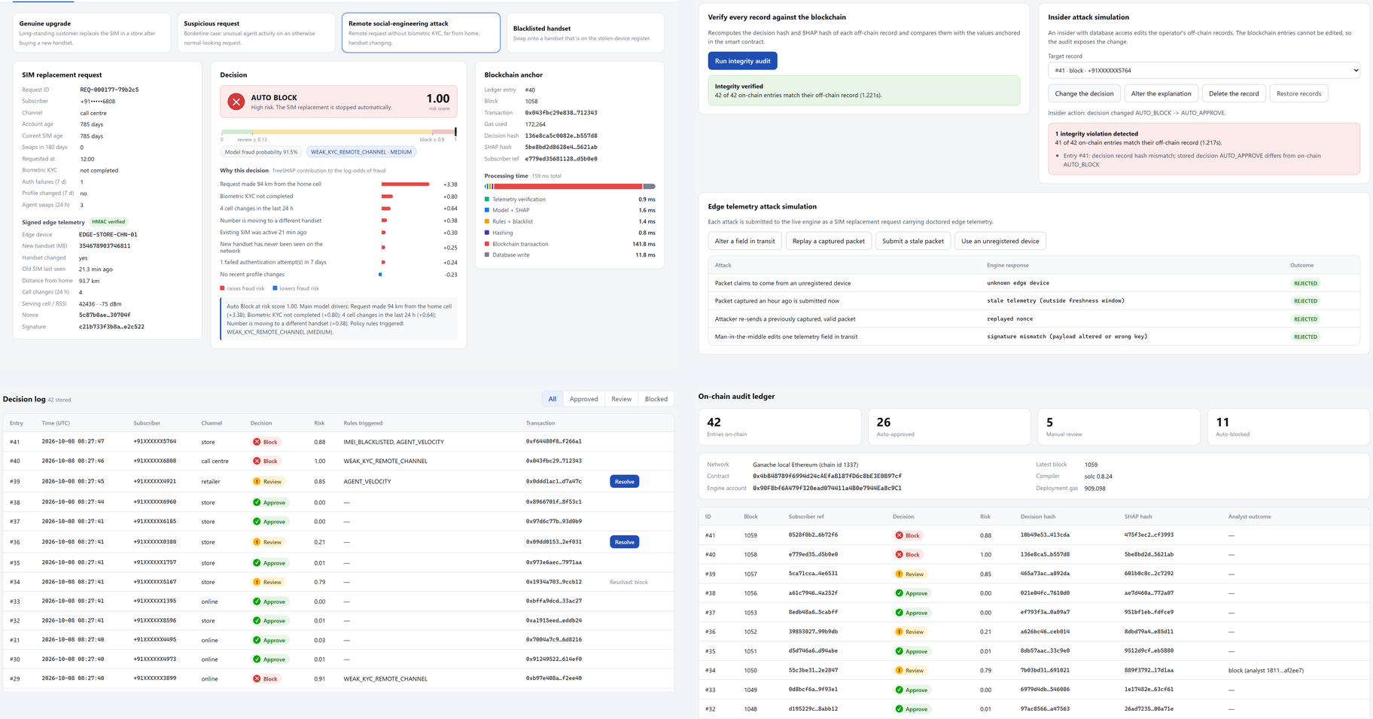
10. SIMGuard Operations Portal & Website Showcase
Full-Stack Web Interface for Telecom Operators, Fraud Analysts & Auditors
PRESENTER: KRISH & YUKESH
Portal Sub-Systems
1. Evaluate Engine (Top-Left):
Interactive request console with presets, signed edge telemetry, and instant 3-tier verdict banners.
2. Tamper Detector (Top-Right):
Cryptographic audit engine displaying flashing red alerts when database rows disagree with on-chain roots.
3. Decision Audit Log (Bottom-Left):
Full chronological log of all evaluate events with the 'Resolve' action for manual reviews.
4. Blockchain Explorer (Bottom-Right):
Live contract overview displaying mined blocks, transaction hashes, and gas usage.

Slide 12
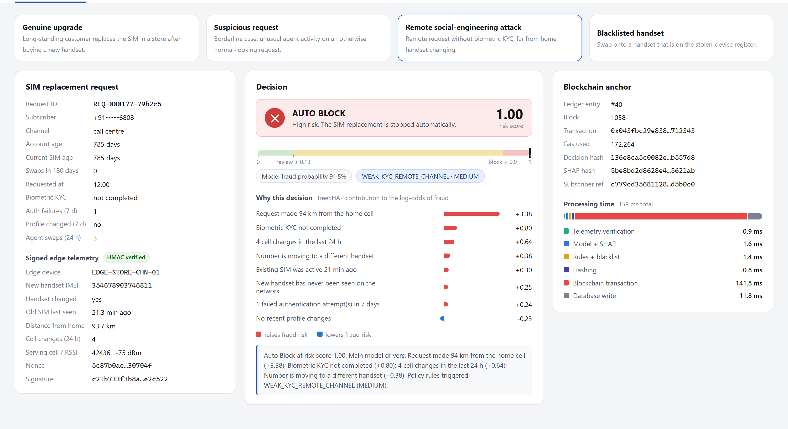
11. Live Demonstration & Viva Walkthrough
Real-Time Demonstration of SIM Replacement, XAI & Blockchain Tamper Detection
PRESENTER: KRISH & YUKESH
Live Viva Demo Modules
1. Evaluate View (Live Swaps):
Demonstrates immediate auto-approval for legitimate customers and real-time auto-blocking for remote social-engineering attacks with signed telemetry.
2. Real-Time SHAP Explanations:
Interactive waterfall bars show exactly which features pushed the risk score above the block threshold.
3. Decision Log & Review Resolution:
Demonstrates human analyst workflow: reviewing flagged swaps and recording signed manual resolutions on-chain.
4. Tamper Demo (10-Second Test):
Click 'Tamper Record' in SQLite database -> Run audit -> Instant red alert proving blockchain catches insider record alterations.

Slide 13
12. Novelty, Limitations & Future Scope
Academic Rigor: Explicit Scope Boundaries and Real-World Roadmap
PRESENTER: KRISH
Core Novelty Contributions
• First framework unifying Explainable AI with EVM blockchain anchoring for telecom SIM replacement.
• Anchoring the explanation itself rather than just an opaque risk score, guaranteeing legal accountability.
• Cryptographically authenticated edge gateway dialogue defeating point-of-sale telemetry injection.
• Complete working prototype with zero simulated fake results.
Honest Scope Boundaries
• Dataset is synthetic and generated from 4 explicit fraud models rather than proprietary carrier logs.
• Edge layer (SIM800L & ESP32) is emulated in software; no live RF radio measurements were collected.
• Blockchain node runs on local Ganache rather than public Ethereum Sepolia network.
Future Roadmap
• Fabricate physical PCB edge gateway with hardware Secure Element (Ateg ATECC608A) for keys.
• Deploy Solidity contracts to public Ethereum Layer-2 rollups (Arbitrum/Optimism) for sub-cent gas.
• Integrate Graph Neural Networks (GNN) to uncover coordinated multi-subscriber SIM swap syndicates.

Slide 14
CONCLUSION & SUMMARY
SIMGuard proves that telecom SIM replacement decisions can be made highly accurate (ROC-AUC 0.948), explained in actionable terms an analyst can understand (TreeSHAP), and anchored so that neither the decision nor its explanation can be quietly rewritten by corrupt insiders (Ethereum Smart Contracts).
By treating the explanation as part of the immutable evidence, SIMGuard transforms opaque fraud scoring into an accountable, legally verifiable security architecture.
Thank you!
We are now ready for your questions and the live prototype demonstration.

